Slide 1


Lecture1: Section 1.1
Nahid Majd, CSUSM
Computer Networking: A Top Down Approach
6th edition
Jim Kurose, Keith Ross
Addison-Wesley
March 2012
What is Internet?
What’s a protocol?
Introduction
1-<number>

Slide 2
Chapter 1: introduction
our goal:
get “feel” and terminology
more depth, detail later in course
approach:
  use Internet as example
overview:
what’s the Internet?
what’s a protocol?
network edge; hosts, access net, physical media
network core: packet/circuit switching, Internet structure
performance: loss, delay, throughput
protocol layers, service models
Introduction
1-<number>

Slide 3
Chapter 1: roadmap
  1.1 what is the Internet?
  1.2 network edge
    end systems, access networks, links
  1.3 network core
    packet switching, circuit switching, network structure
  1.4 delay, loss, throughput in networks
  1.5 protocol layers, service models
Introduction
1-<number>

Slide 4
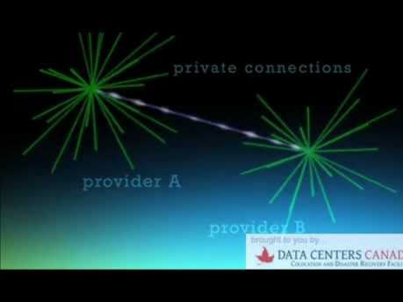
What’s Internet?
How does the Internet work?
How do we connect to Facebook? Twitter?
How do we get email?
How do we stream video?
Video – How does the internet work? (Watch 1st three minutes)
Introduction
1-<number>

Slide 5
What’s Internet?
We can describe Internet from two aspects:
Nuts and bolts view : in terms of hardware and software components
A service view: An infrastructure for providing services to distributed applications
Introduction
1-<number>

Slide 6




















What’s the Internet: “nuts and bolts” view
PC
millions of connected computing devices:
  hosts = end systems
  running network apps
mobile network
server
wireless
laptop
global ISP
smartphone
home
network
communication links
  fiber, copper, radio, satellite
  transmission rate: bandwidth
regional ISP
wireless
links
wired
links
Packet switches: forward packets (chunks of data)
  routers and switches
router
institutional
network
switch
Introduction
1-<number>

Slide 7
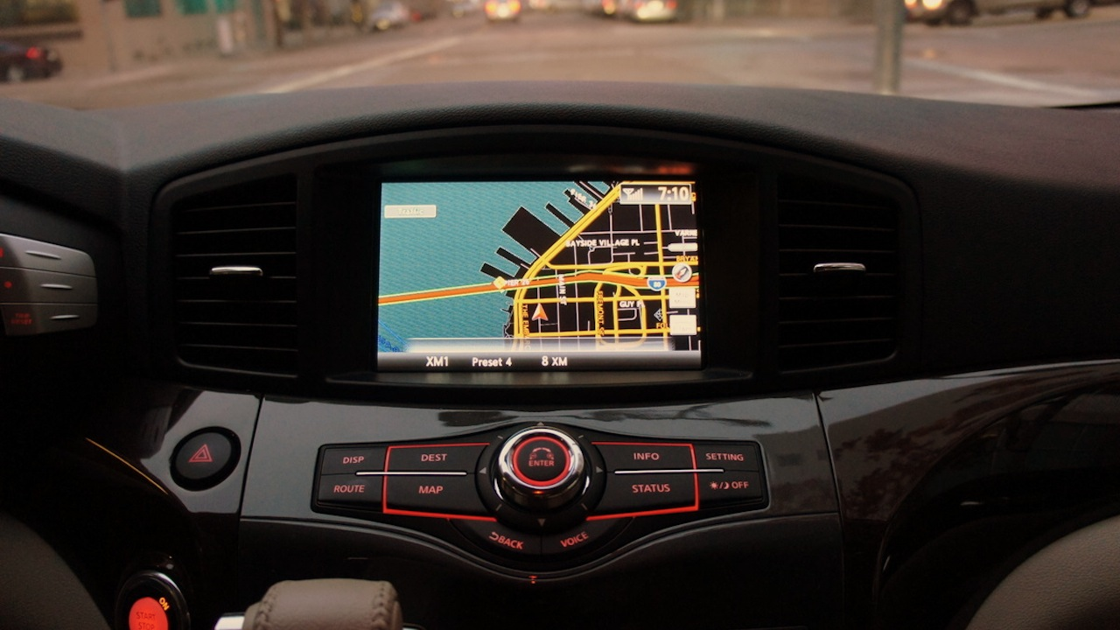
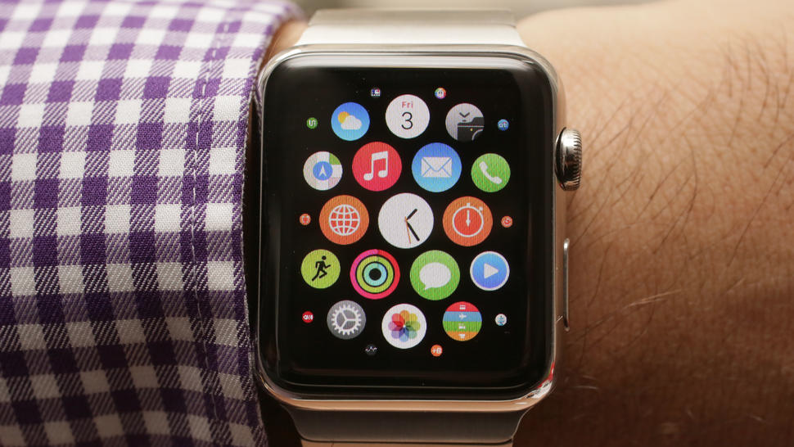
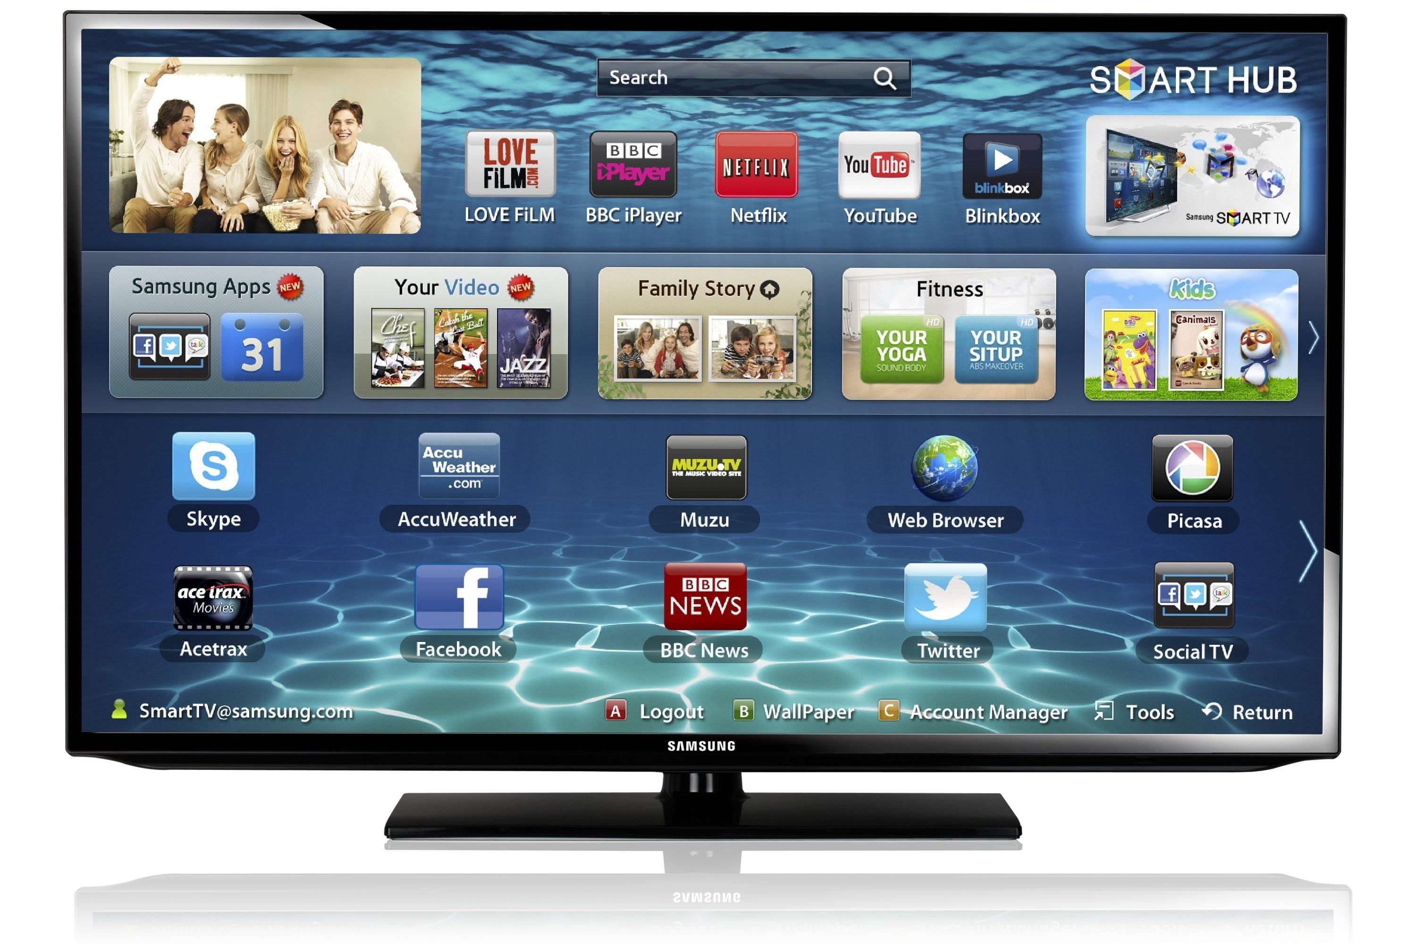
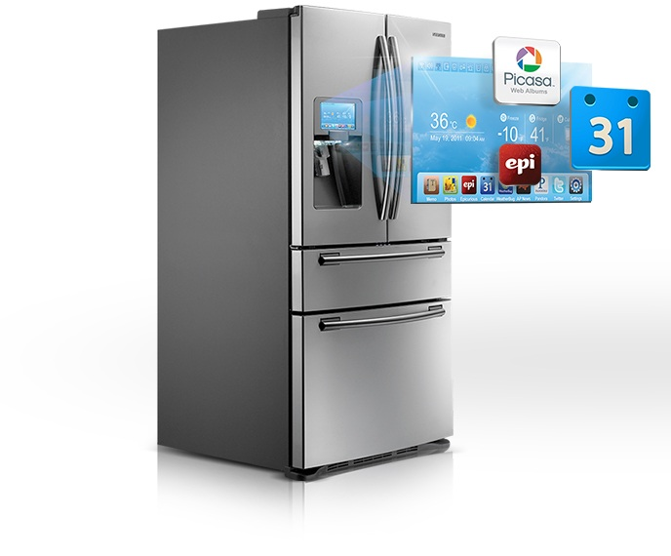
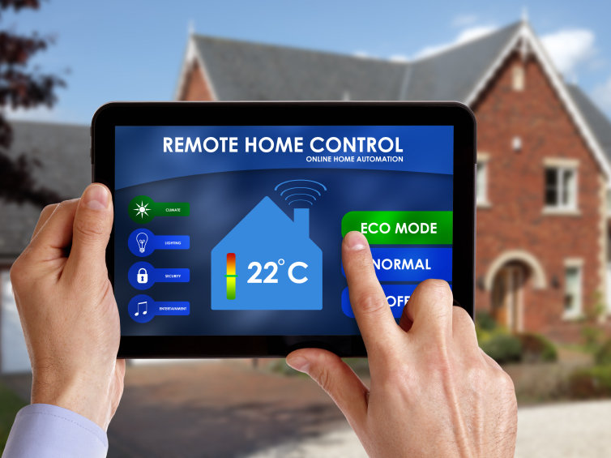

Fun Internet appliances!
Smart TV
Car GPS
Smart watch
Internet
refrigerator
Social toaster
Remote home control
Introduction
1-<number>

Slide 8
What’s the Internet: “nuts and bolts” view
Internet: “network of networks”
  Interconnected ISPs
protocols control sending, receiving of msgs
  e.g., TCP, IP, HTTP, Skype, 802.11
Internet standards
  RFC: Request for comments
  IETF: Internet Engineering Task Force
  Internet standards are called RFCs, which are developed by IETF
WiFi vs. 4G?
  http://www.antennasearch.com
  OpenSignal App: 4G coverage
mobile network
global ISP
home
network
regional ISP
institutional
network
Introduction
1-<number>

Slide 9
Analogy: Pkt Networks and Transportation Networks
Transportation Networks
Transports vehicles
Network of roads, highways, intersections
A factory sends a large amount of cargo to a destination warehouse
At the factory, the cargo is segmented and loaded into a fleet of trucks
At the destination warehouse, the cargo is unloaded and grouped with the rest of cargo from the same shipment
Pkt Networks
Transports packets
Network of links, connections, switches
A source end-system sends a message to a destination end-system
At the source end-system, the message is segmented into packets
At the destination end-system, the message is reconstructed with the received packets belong to the same message
Introduction
1-<number>

Slide 10
What’s the Internet: a service view
mobile network
Internet is an Infrastructure that provides services to applications:
  Web, VoIP, email, games, e-commerce, social nets, …
Internet provides programming interface to applications
  hooks that allow sending and receiving app programs to “connect” to Internet
  provides service options, analogous to postal service
global ISP
home
network
regional ISP
institutional
network
Introduction
1-<number>

Slide 11
What’s a protocol?
human protocols:
“what’s the time?”
“I have a question”
introductions
… specific msgs sent
… specific actions taken when msgs received, or other events
If two people don’t know each others’ protocols, they cannot communicate.
network protocols:
machines rather than humans
all communication activity in Internet governed by protocols
protocols define format and order of msgs sent and received among network entities, and actions taken on msg transmission and receipt
Introduction
1-<number>

Slide 12

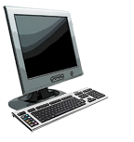

What’s a protocol?
a human protocol and a computer network protocol:
Hi
TCP connection
request
Hi
TCP connection
response
Got the
time?
Get http://www.awl.com/kurose-ross
2:00
<file>
time
Introduction
1-<number>

Slide 13
Network: What is it?
Network
  Group of computers and devices
    Connected by transmission media
Stand-alone computer
  Not connected to other computers (not networked)
  Uses local software and data
Advantages of networks
  Device sharing by multiple users
    Saves money and time
  Central network management
  Can participate in the Internet
Introduction
1-<number>

Slide 14
Client/server Networks
Server
  Central computer
  Facilitates communication and resource sharing
Clients
  Personal computers
  Also known as workstations
Central resource sharing controlled by server
  Sharing data, storage space, devices
  No direct sharing of client resources
Introduction
1-<number>

Slide 15
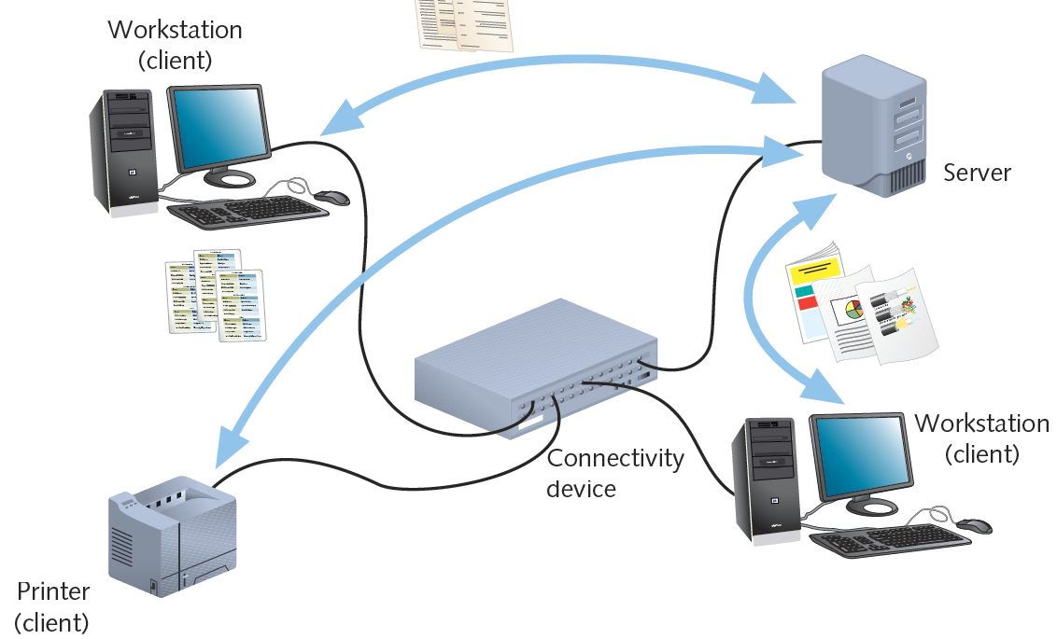
Client/Server Networks (cont’d.)
Introduction
1-<number>

Slide 16
Client/Server Networks (cont’d.)
Server
  More memory, processing, storage capacity
  Equipped with special hardware
    Provides network management functions
Clients
  Run local applications
  Store data locally
  Use server shared applications, data, devices
  Use server as intermediary
Introduction
1-<number>

Slide 17
Client/Server Networks (cont’d.)
Server requirement
  Network operating system
    Manages client data, resources
    Ensures authorized user access
    Controls user file access
    Restricts user network access
    Dictates computer communication rules
    Supplies application to clients
Server OS examples
  Microsoft Windows Server
  MAC OS X Server
  Ubuntu Server
Introduction
1-<number>

Slide 18
LANs, MANs, and WANs
LAN (local area network)
  Network confined to a relatively small space (same building)
MAN (metropolitan area network)
  Connects clients and servers from multiple buildings
  Uses different transmission media and technology than LAN
WAN (wide area network)
  Connects two or more geographically distinct LANs or MANs
  Uses different transmission methods and media than LAN
  Network connection
    Separate offices in same organization
      Qualcomm has 157 worldwide locations
    Separate offices in different organizations
      Qualcomm has offices at Google, Apple, …
Introduction
1-<number>

Slide 19
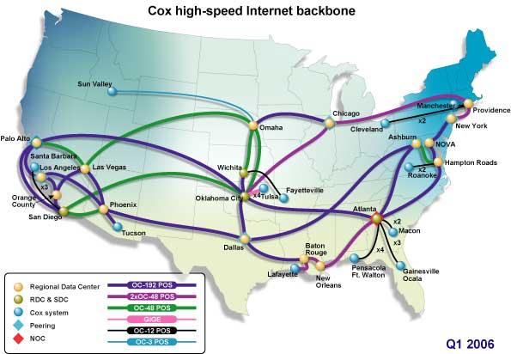
Elements common to networks
Segment
  Group of nodes
  Uses same communications channel for traffic
Backbone
  Connects segments and significant shared devices
  Creates “A network of networks”
Topology
  Computer network physical layout
  Ring, bus, star or hybrid formation
http://www.amdbuilder.net/assets/images/backbone.jpg
Introduction
1-<number>

Slide 20
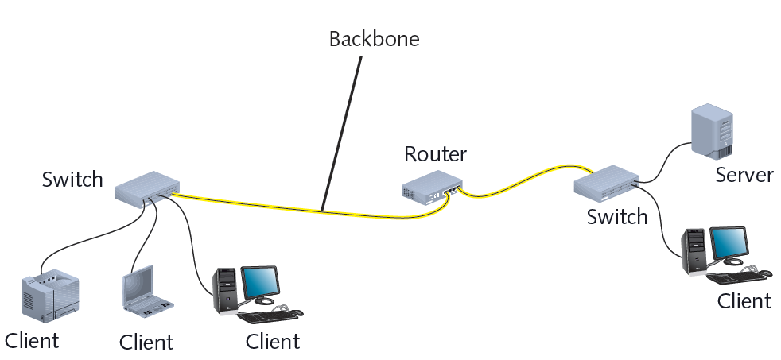
Interconnected LANs
Introduction
1-<number>

Slide 21
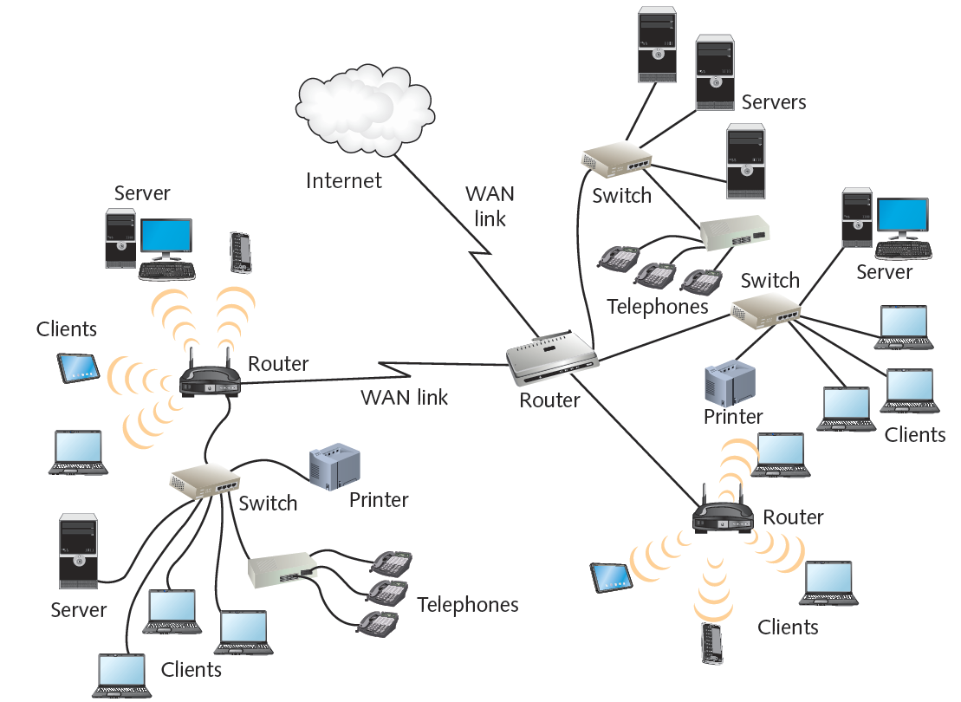
WAN
Introduction
1-<number>

Slide 22
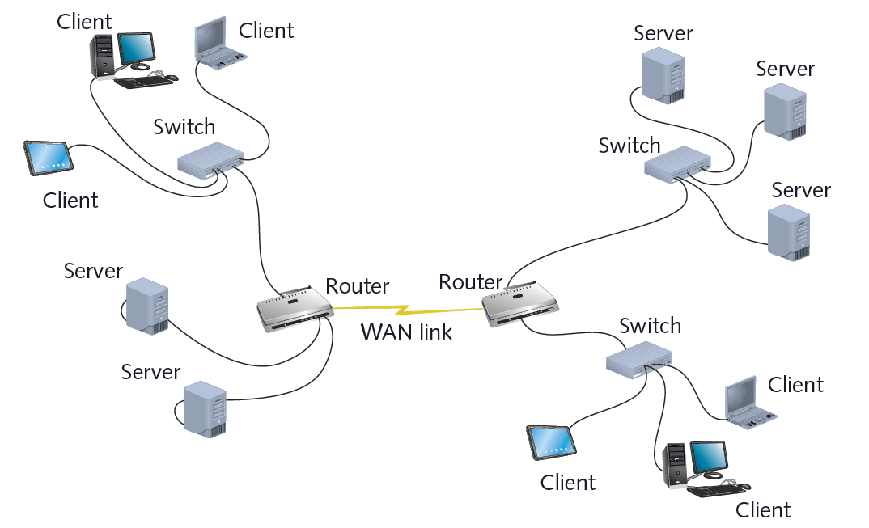
Another structure of a WAN
Introduction
1-<number>

Slide 23
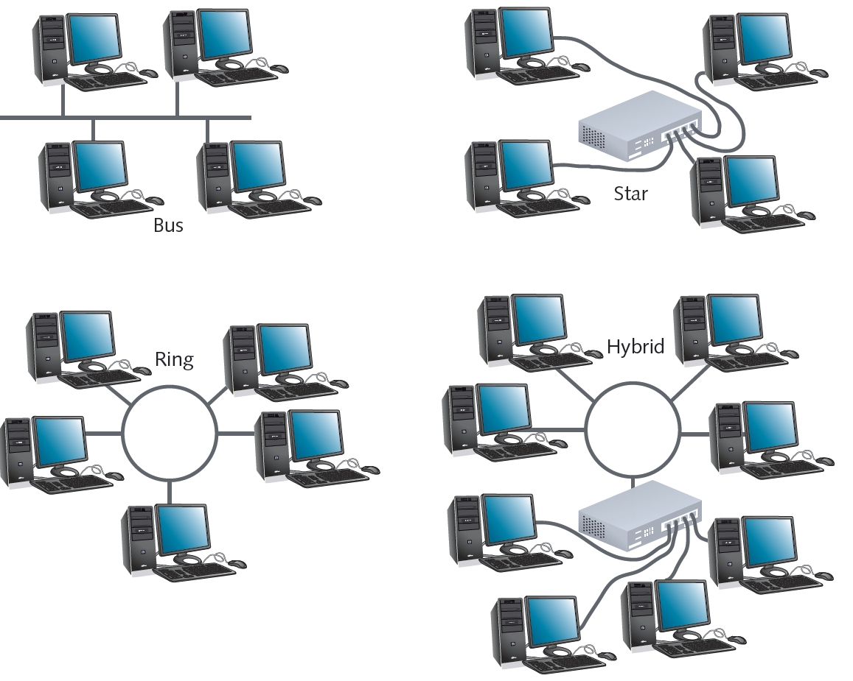
Common network topologies
Introduction
1-<number>

Slide 24
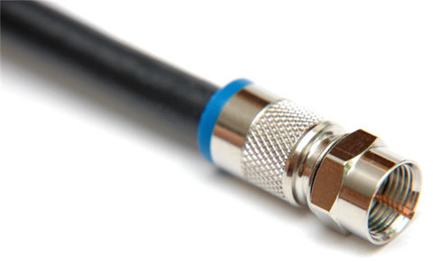
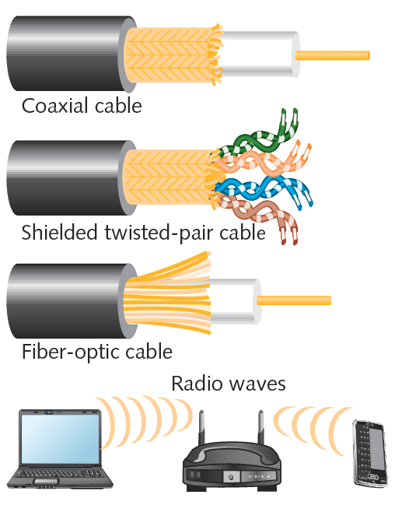
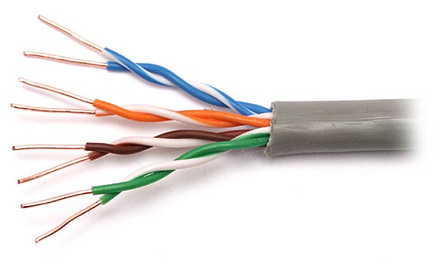
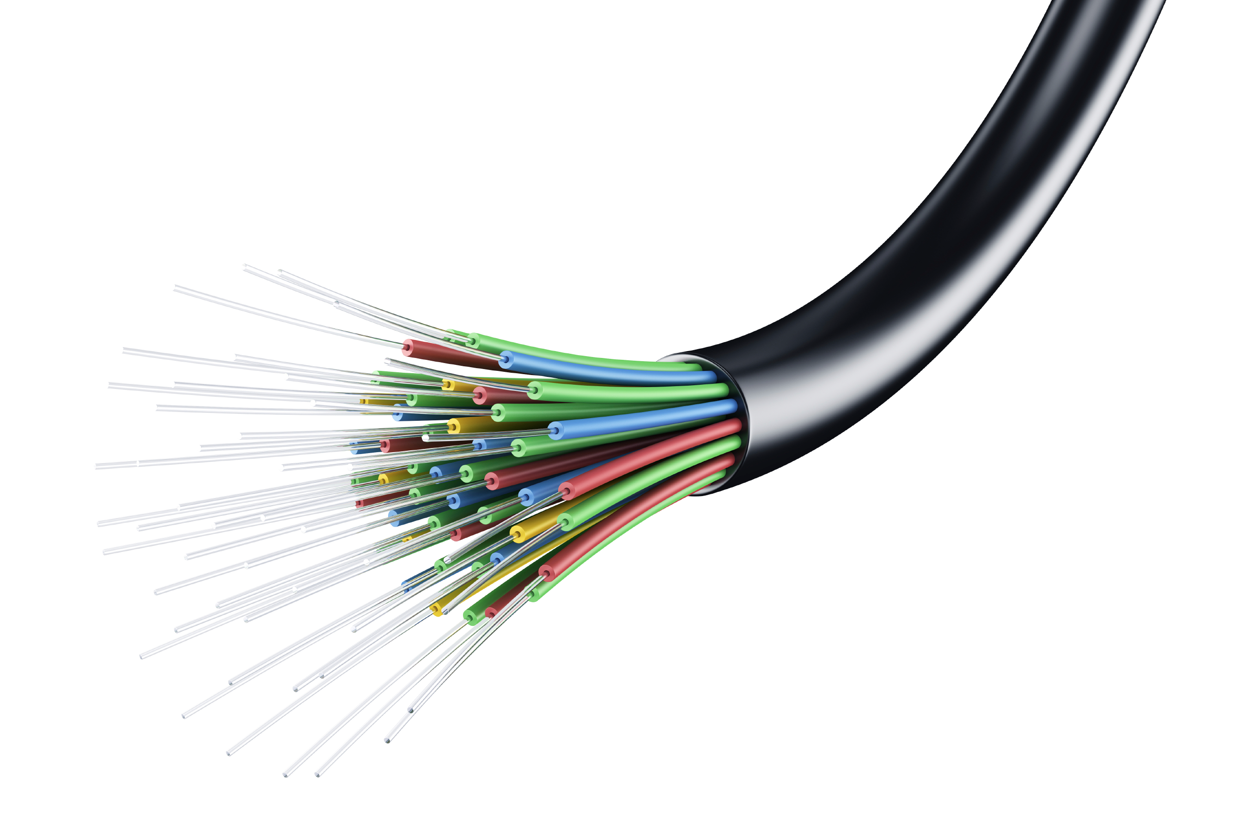
network transmission media
Introduction
1-<number>

Slide 25
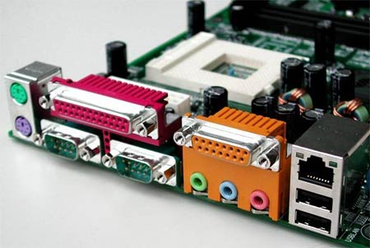
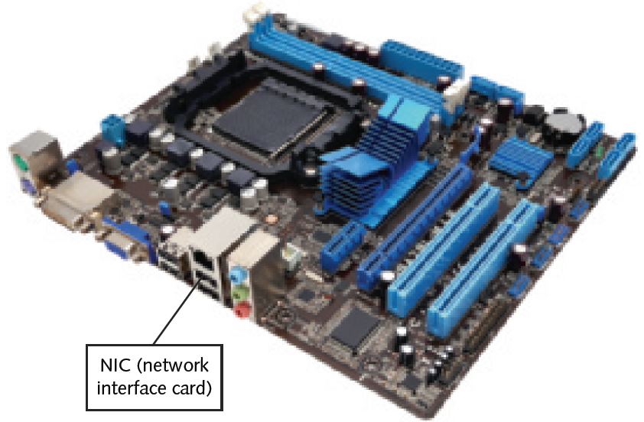
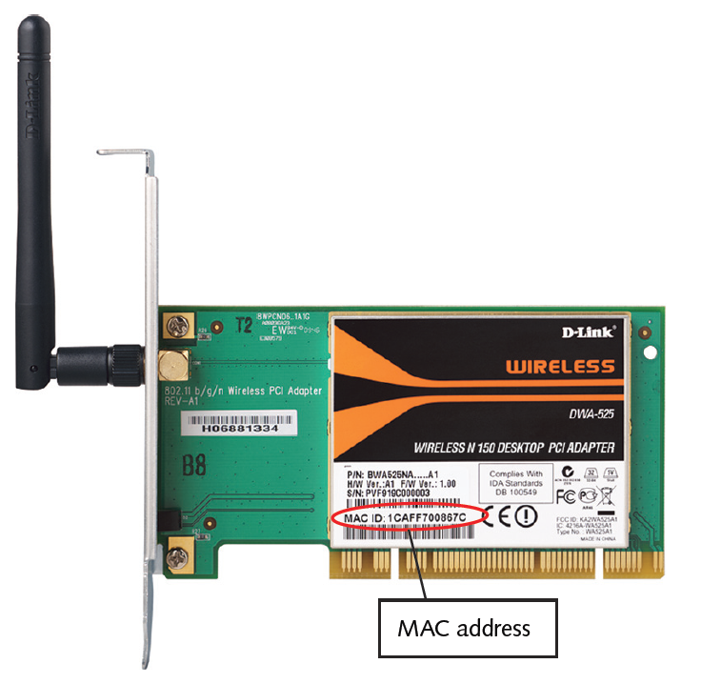
NIC (network interface card)
Introduction
1-<number>

Slide 26
How Networks Are Used
Network services
  Functions provided by a network
  E-mail
  Printer sharing
  File sharing
  Internet access and Web site delivery
  Remote access capabilities
  Voice (telephone) and video services
  Network management
Introduction
1-<number>

Slide 27
Access Services
Allow remote user network connection
Allow network users to connect to machines outside the network
Remote user
  Computer user on different network or in different geographical location from LAN’s server
Network operating systems include built-in access services
Introduction
1-<number>

Slide 28
Becoming a Networking Professional
Job market
  Many job postings for computer professionals
  Expertise levels required vary
To prepare for entering job market:
  Master general networking technologies
  Select and study areas of interest
  Hone communication and teamwork skills
  Stay abreast of emerging technologies
  Consider professional certification
  Get to know others in your field
Introduction
1-<number>

Slide 29
Mastering the Technical Challenges
Skills to acquire
  Installing, configuring, troubleshooting network server and client hardware and software
  Understanding characteristics of transmission media
  Understanding network design
  Understanding network protocols
  Understanding how users interact with network
  Constructing a network with clients, servers, media, and connectivity devices
  Net+ certificate
    A good source of preparing tutorial for Net+ is:
    https://www.youtube.com/playlist?list=PL1F6C1ACECE163B3E
  CCNA certificate
    https://www.youtube.com/watch?v=n2D1o-aM-2s
Introduction
1-<number>

Slide 30
Pursuing Certification
Professional organizations
  CompTIA
    Network+
    Security+
CSUSM EL courses to prepare for the certificates
  CompTIA
    https://www.csusm.edu/el/certificateprograms/comptech/comptia.html
uCertify: a provider of online test prep Courses & Labs for all major IT certifications.
  Comp TIA Network+ and Security+
  Cisco CCNA
Introduction
1-<number>

